Slide 1

JS for Front-End
Introduction to Bootstrap
SoftUni Team
Technical Trainers
Software University
http://softuni.bg

Slide 2
Table of Content
What is Bootstrap
How to import Bootstrap?
Grid System
Styling Components

Slide 3
Have a Question?
sli.do
#JS-CORE

Slide 4

What is Bootstrap?
Build responsive, mobile-first projects

Slide 5

Bootstrap
World's most popular front-end component library
Open source toolkit for developing with HTML, CSS, and JS
Works with
Responsive grid system
Extensive prebuilt components
Powerful plugins built on jQuery

Slide 6

How to Import Bootstrap?
Import Options

Slide 7
Include from a Bootstrap CDN - CSS
Sometimes you need to include only a specific module
You can do that, using BootstrapCDN
Include Bootstrap's compiled and minified CSS
Only CSS
<link rel="stylesheet" href="https://stackpath.bootstrapcdn.com/bootstrap/4.1.2/css/bootstrap.min.css"/>

Slide 8
Include from a BootstrapCDN – JS
Be sure to place jQuery and Tether first, as the Bootstrap code depends on them
JavaScript, Popper.js and jQuery
<script src="https://code.jquery.com/jquery-3.3.1.slim.min.js"></script>
<script src="https://cdnjs.cloudflare.com/ajax/libs/tether/1.4.0/js/
tether.min.js"></script>
<script src="https://stackpath.bootstrapcdn.com/bootstrap/4.1.2/js/ bootstrap.min.js"></script>

Slide 9
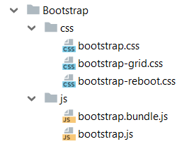
Download Resources
Compiled and minified CSS, JavaScript, and fonts. No docs or original source files are included.
<link rel="stylesheet" href="../bootstrap/css/bootstrap.min.css"/>
<script src="../jquery/jquery.3.2.1.min.js">
</script>
<script src="../bootstrap/js/bootstrap.min.js"></script>

Slide 10

Bootstrap Grid System
Build Layouts with Grid - Twelve Column System

Slide 11

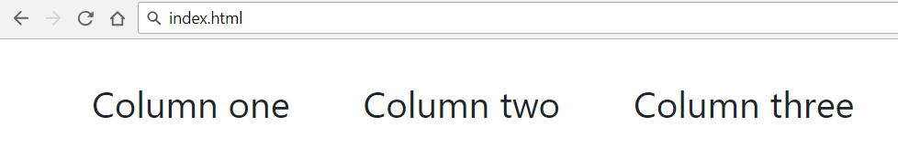
Bootstrap Grid System Demo
index.html
…
<div class="container">
<div class="row">
<div class="col-xs m-3">Column one</div>
<div class="col-xs m-3">Column two</div>
<div class="col-xs m-3">Column three</div>
</div>
</div>
…
Container
Row
Columns

Slide 12
Bootstrap Containers
Rows must be placed in containers
.container has one fixed width for each screen size in bootstrap (xs,sm,md,lg)
.container-fluid expands to fill the available width
Responsive pixel width
width: 100%

Slide 13

Column Classes
Determines how many columns to use on different screen size
.col-xs: width less than 768px
.col-sm: width between 768px and 992px
.col-md: width between 992px and 1200px
.col-lg: width over 1200px
index.html
<div class="col-sm-8 col-lg-4">Column one</div>
<div class="col-sm-2 col-lg-4">Column two</div>
<div class="col-sm-2 col-lg-4">Column three</div>

Slide 14
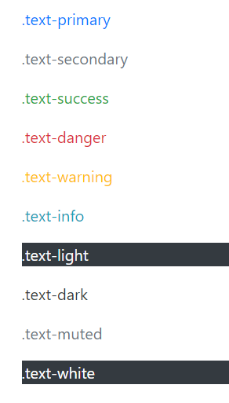
Color
Handful of color utility classes
index.html
<p class="text-primary">.text-primary</p>
<p class="text-secondary">.text-secondary</p>
<p class="text-success">.text-success</p>
<p class="text-danger">.text-danger</p>
<p class="text-warning">.text-warning</p>
<p class="text-info">.text-info</p>
<p class="text-light bg-dark">.text-light</p>
<p class="text-dark">.text-dark</p>
<p class="text-muted">.text-muted</p>
<p class="text-white bg-dark">.text-white</p>

Slide 15
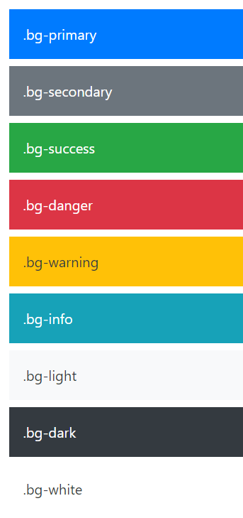
Background Color
Easily set the background of an element to any contextual class
index.html
<div class="bg-primary text-white">.bg-primary</div>
<div class="bg-secondary text-white">.bg-secondary</div>
<div class="bg-success text-white">.bg-success</div>
<div class="bg-danger text-white">.bg-danger</div>
<div class="bg-warning text-dark">.bg-warning</div>
<div class="bg-info text-white">.bg-info</div>
<div class="bg-light text-dark">.bg-light</div>
<div class="bg-dark text-white">.bg-dark</div>
<div class="bg-white text-dark">.bg-white</div>

Slide 16
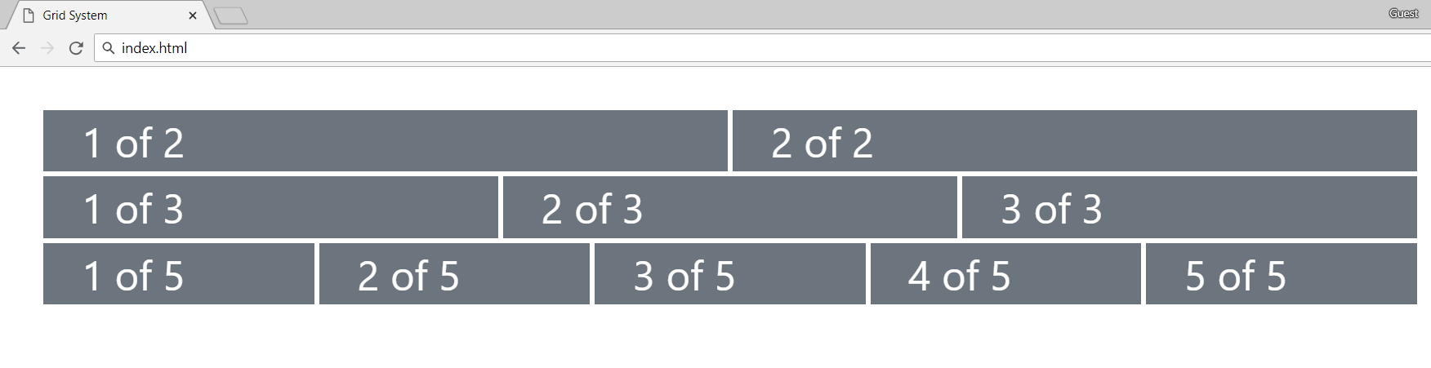
Problem: Grid System
Create a page like the following, using Bootstrap Grid System
Use class row for every line
Define containers with class col inside every row

Slide 17

Theming Bootstrap
Enable the Built-in Theme to Add Components

Slide 18

Bootswatch
Bootswatch is a collection of open source themes for Bootstrap
Usage
Download the bootstrap.min.css file
Replace Bootstrap's default stylesheet
Still include Bootstrap's JavaScript file to have functional dropdowns, modals, etc.

Slide 19

Bootstrap Components
Over a Dozen Reusable Components

Slide 20
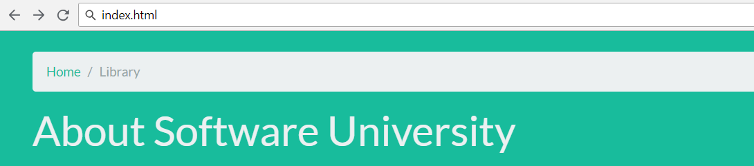
Page Header and Breadcrumbs
Indicate the current page's location within a navigational hierarchy
<body class="bg-success">
<div class="container m-4">
<div class="page-header">
<ol class="breadcrumb">
<li class="breadcrumb-item"><a href="#">Home</a></li>
<li class="breadcrumb-item active">Library</li>
</ol>
<h1 class="h1 text-light">About Software University</h1>
</div>
</div>
</body>

Slide 21
Button Groups
Custom button styles with support for multiple sizes, states, and more
index.html
<button type="button" class="btn btn-primary">Primary</button>
<button type="button" class="btn btn-secondary">Secondary</button>
<button type="button" class="btn btn-success">Success</button>
<button type="button" class="btn btn-danger">Danger</button>
. . .
Documentation: https://getbootstrap.com/docs/4.0/components/buttons/

Slide 22
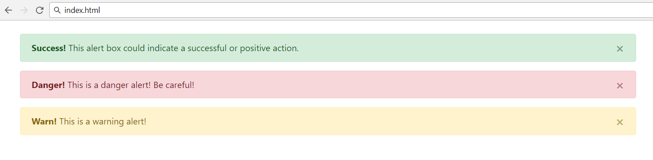
Alerts
Provide contextual feedback messages for typical user actions with the handful of flexible alert messages
<div class="alert alert-success alert-dismissable">
<a class="close" data-dismiss="alert" aria-label="close">×</a>
<strong>Success!</strong> This alert box could indicate a successful or positive action.
</div>
…

Slide 23
Nav and Navbar
Require a wrapping .navbar
Responsive by default
Come with built-in support for a handful of sub-components
.navbar-brand for your company, product, or project name
.navbar-nav for a full-height and lightweight navigation
.nav-item for every item in navigation
See more at: https://getbootstrap.com/docs/4.0/components/navbar/

Slide 24
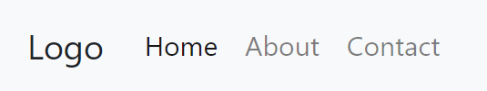
Nav and Navbar with Bootstrap
<nav class="navbar navbar-expand-lg navbar-light bg-light">
<div class="collapse navbar-collapse">
<a class="navbar-brand">Logo</a>
<ul class="navbar-nav mr-auto">
<li class="nav-item">
<a class="nav-link" href="#">Home</a>
</li>
<li class="nav-item">
<a class="nav-link" href="#">About</a>
</li>
<li class="nav-item">
<a class="nav-link" href="#">Contact</a>
</li>
</ul>
</div>
</nav>

Slide 25
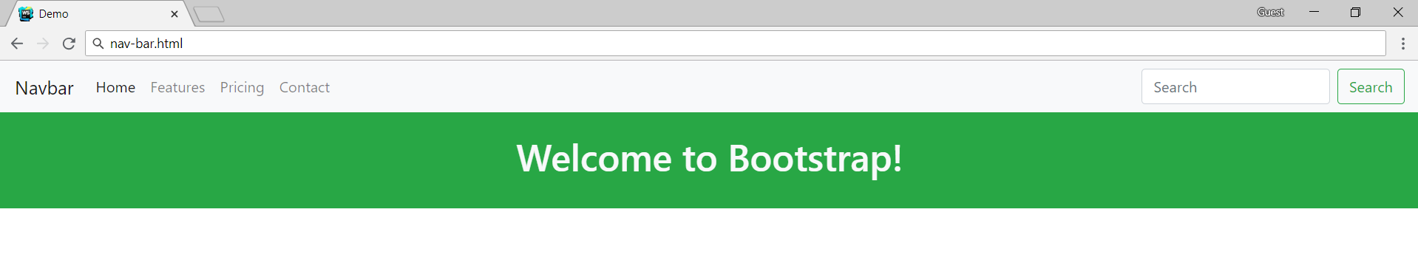

Problem: Navigation Bar
Create the following navigation bar using Bootstrap
Take a look at documentation and examples for Bootstrap's powerful, responsive navbar

Slide 26
Solution: Navigation Bar
<div class="container-fluid pl-0 pr-0">
<nav class="navbar navbar-expand-lg navbar-light bg-light">
<a class="navbar-brand" href="#">Navbar</a>
<div class="collapse navbar-collapse">
<ul class="navbar-nav">
<li class="nav-item active">
<a class="nav-link" href="#">Home</a>
</li>
<li class="nav-item">
<a class="nav-link" href="#">Features</a>
</li>
. . .
</ul>
</div>
... // Continues the next slide...

Slide 27
Solution: Navigation Bar (2)
...
<form class="form-inline">
<input class="form-control mr-sm-2" type="search" placeholder="Search" aria-label="Search">
<button class="btn btn-outline-success my-2 my-sm-0" type="submit">Search</button>
</form>
</nav>
</div>
<div class="container-fluid p-4 bg-success">
<h1 class="h1 text-center text-light">
Welcome to Bootstrap!
</h1>
</div>

Slide 28
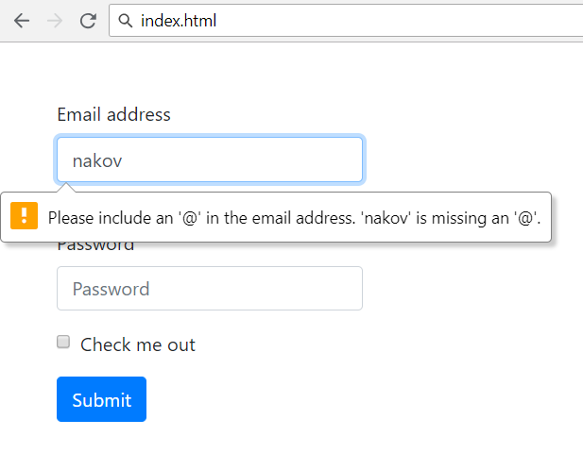
Forms
Form control styles, layout options and custom components for creating a wide variety of forms
Use type attribute on all inputs to take advantage of newer input controls
Email verification
Number selection

Slide 29
Forms (2)
<form>
<div class="form-group">
<label for="exampleInputEmail1">Email address</label>
<input type="email" class="form-control" id="exampleInputEmail1" aria-describedby="emailHelp" placeholder="Enter email">
<small id="emailHelp" class="form-text text-muted">We'll never share your email with anyone else.</small>
</div>
<div class="form-group">...</div>
<div class="form-check mb-3">
<input type="checkbox" class="form-check-input" id="exampleCheck1">
<label class="form-check-label" for="exampleCheck1">Check out</label>
</div>
<button type="submit" class="btn btn-primary">Submit</button>
</form>

Slide 30
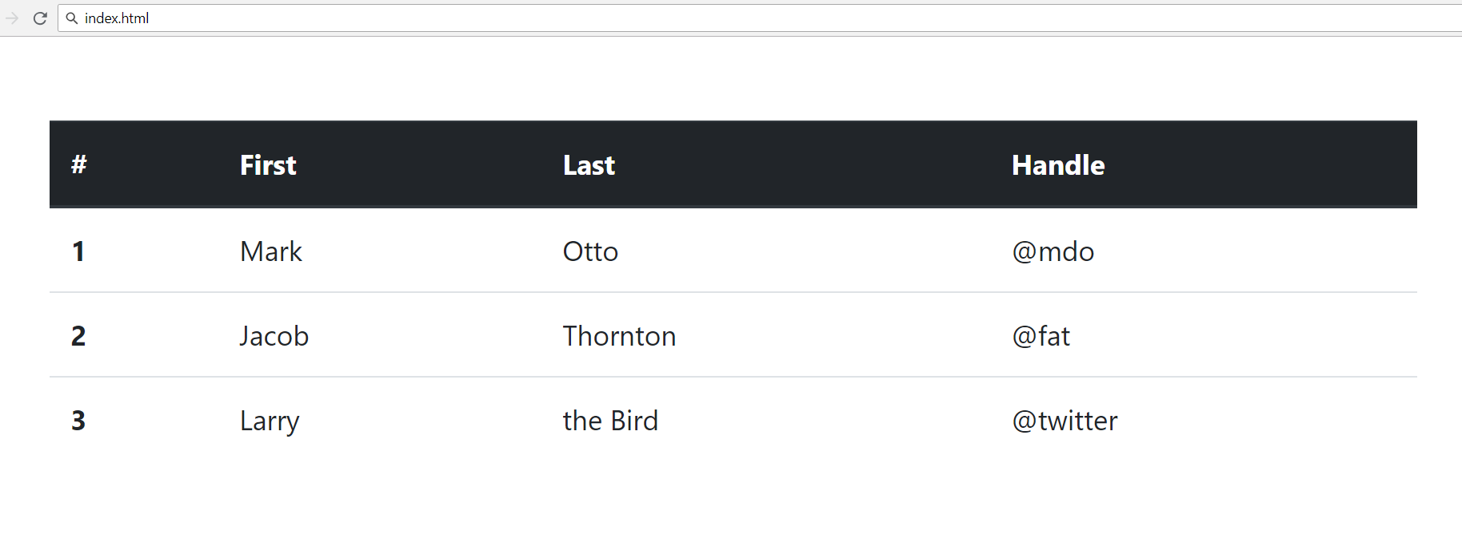
Tables
<table class="table">
<thead class="thead-dark">
<tr> <th scope="col">#</th>
<th scope="col">First</th>
<th scope="col">Last</th>
<th scope="col">Handle</th> </tr>
</thead>
<tbody>
<tr> <th scope="row">1</th>
<td>Mark</td>
<td>Otto</td>
<td>@mdo</td> </tr>
<tr> . . . </tr>
<tr> . . . </tr>
</tbody>
</table>

Slide 31
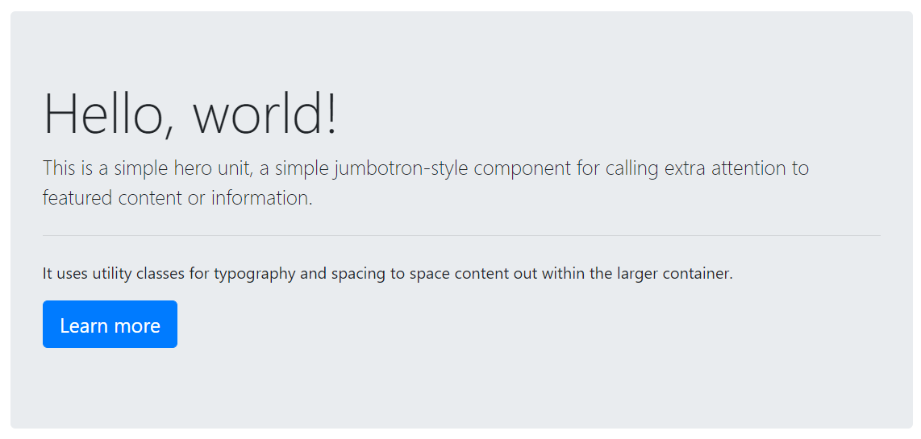
Jumbotron
Lightweight, flexible component for showcasing hero unit style content
<div class="jumbotron">
<h1 class="display-4">Hello, world!</h1>
<p class="lead">This is a ...</p>
<hr class="my-4"><p>It uses ...</p>
<p class="lead">
<a class="btn btn-primary btn-lg">
Learn more</a>
</p>
</div>
See more at: https://getbootstrap.com/docs/4.0/components/jumbotron/

Slide 32

Summary
…
…
…
Bootstrap - the most popular HTML, CSS and JS framework
Responsive, mobile-first, prevailing
Easy to use and to learn it
Free and open source
Simple Integration
12-column responsive grid
Cheatsheet to Bootstrap components

Slide 33
https://softuni.bg/courses/js-apps

Slide 34












SoftUni Diamond Partners

Slide 35




SoftUni Organizational Partners

Slide 36




Trainings @ Software University (SoftUni)
Software University – High-Quality Education and Employment Opportunities
softuni.bg
Software University Foundation
http://softuni.foundation/
Software University @ Facebook
facebook.com/SoftwareUniversity
Software University Forums
forum.softuni.bg

Slide 37

License
This course (slides, examples, demos, videos, homework, etc.) is licensed under the "Creative Commons Attribution-NonCommercial-ShareAlike 4.0 International" license

